Slide 1

“Porte Chai” Tutor Finding App
Presented By:
Suraiya Mahmuda(364)
Choyon Sarker(392)
Group No-18

Slide 2

Contents
Introduction
Problem Statements
Key Features
Technology Stack
App Demonstrations
Challenges
Future Enhancements
Conclusion

Slide 3

Introduction
Porte Chai is a mobile application designed to seamlessly connect students, parents, and tutors. It offers an efficient and user-friendly platform where parents can find qualified tutors for their children, students can find teachers for themselves, and tutors can discover teaching opportunities.

Slide 4

Problems Statements
Difficulty in finding reliable and qualified tutors
Lack of a centralized platform for connecting parents and tutors
Limited communication and feedback systems for trust building
Prevent the Fraud services

Slide 5

Key Features
For Students and Parents
Post Requirements
Communicate with Tutors(via Whatsapp, Phone)
Search for Tutors(Area or Purpose based)
Track and Manage Applications
For Tutors
Finding Jobs
Applying for Tuition Posts
Adding Intro Video
Sent Information to the Post Author

Slide 6

Technology Stack
Frontend: Java (Android Studio)
Backend: Firebase (Firestore/Realtime Database)
Tools:
Firebase Authentication for user management
Firebase Storage for profile images
Firestore/Realtime Database for storing data

Slide 7

Start Our app
Porte Chai Splash Screen

Slide 8
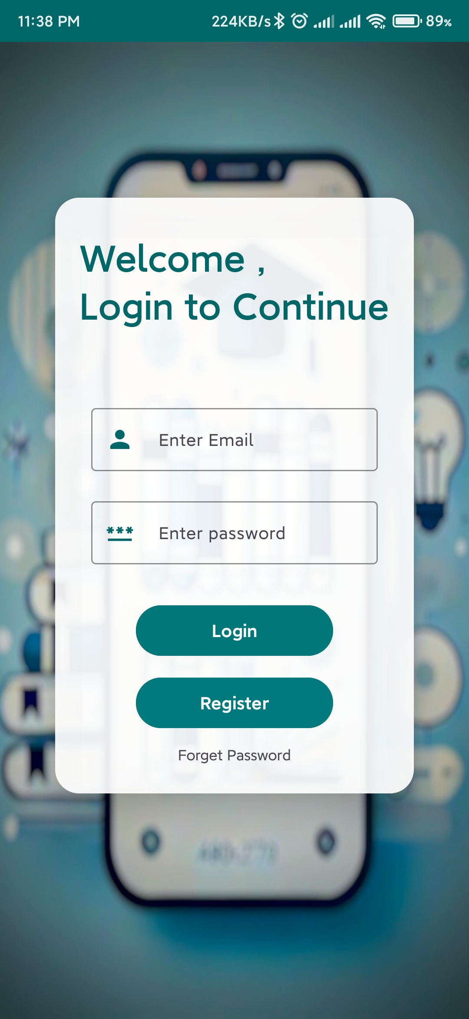
Login and Registration page

Slide 9
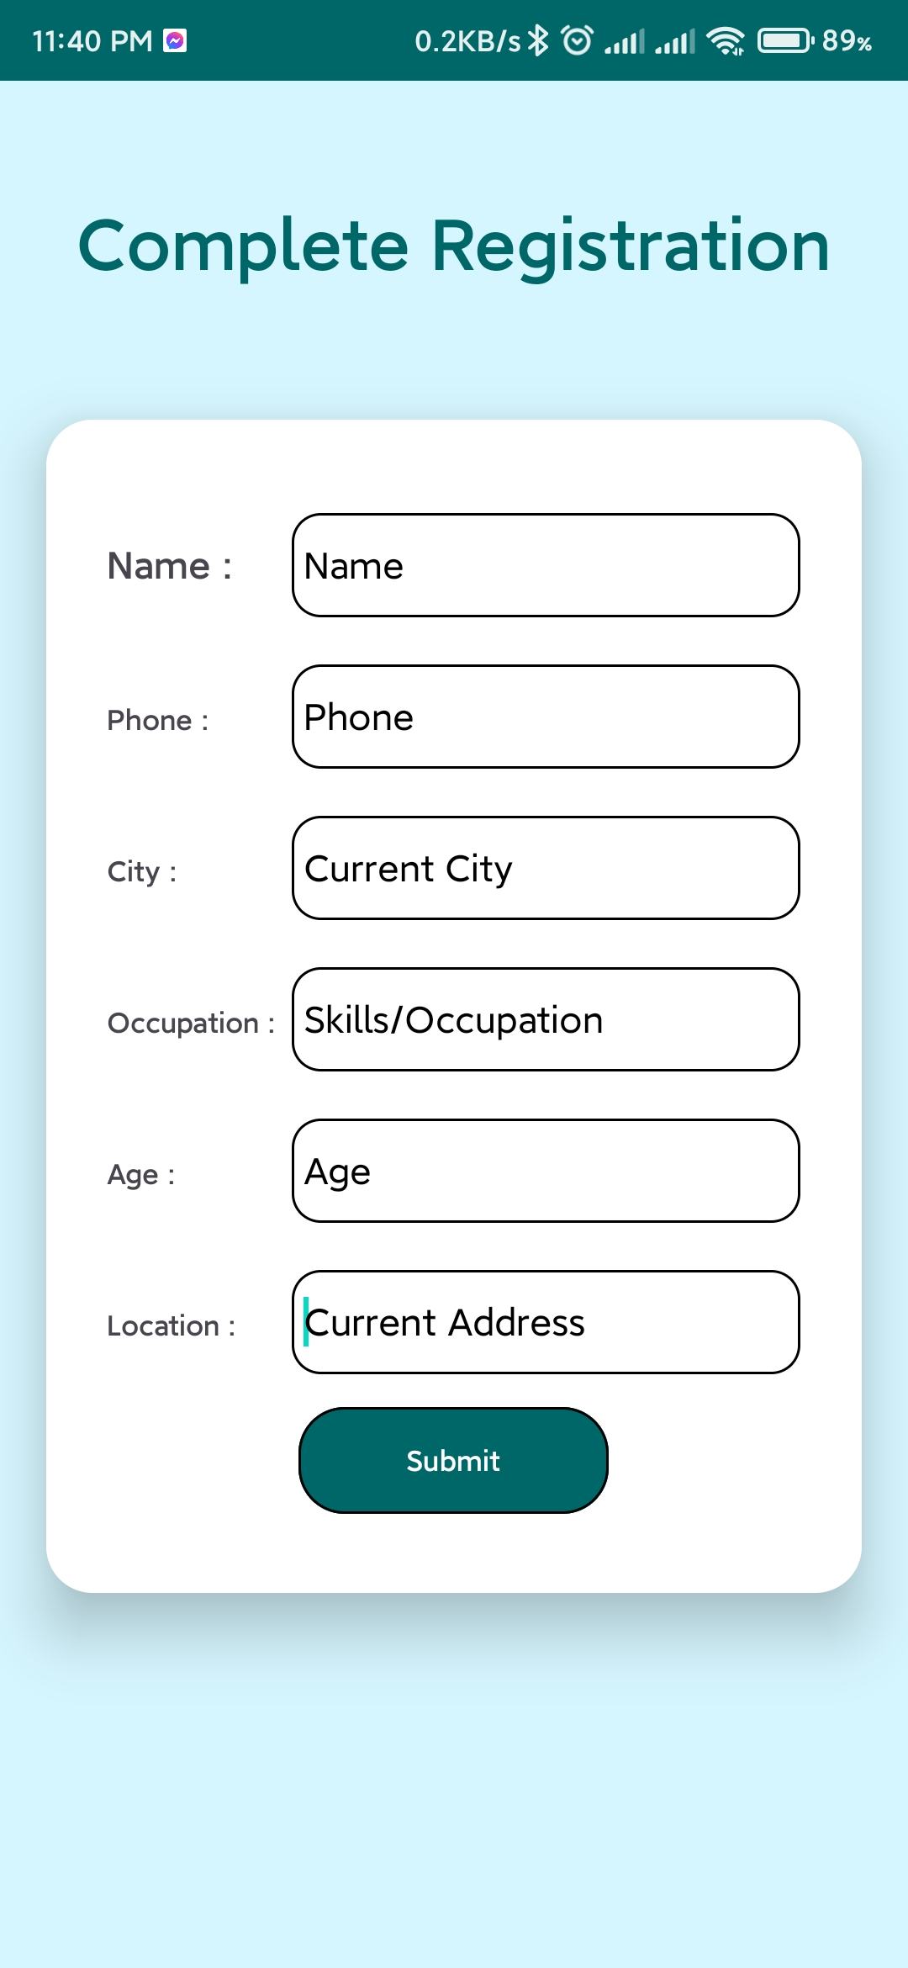
Complete Registration Page

Slide 10
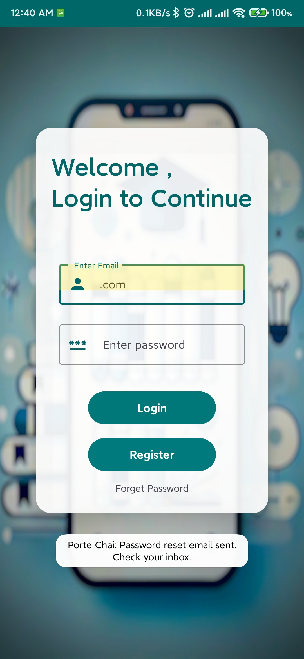
Reset Password

Slide 11
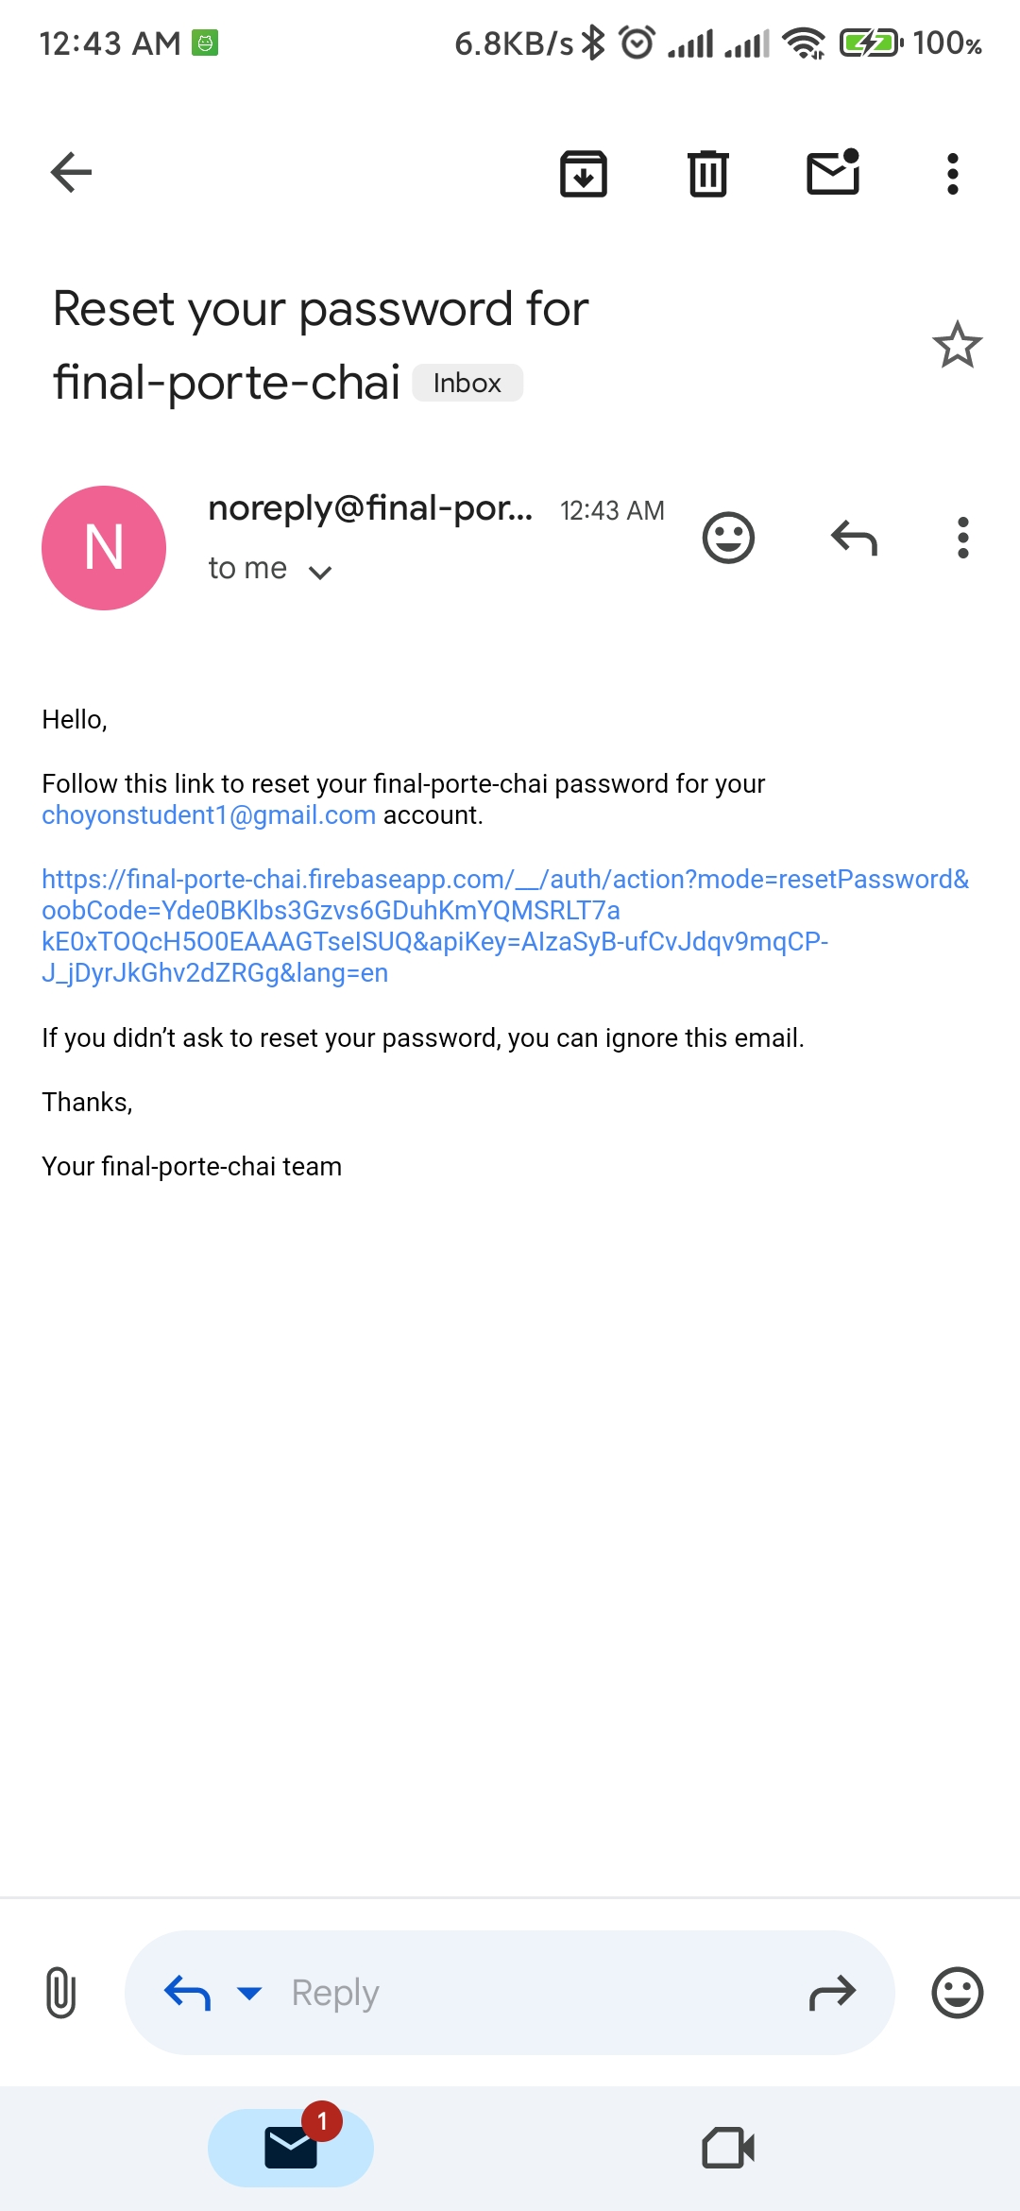
Reset Password via Email

Slide 12

Enter New Password

Slide 13

Password Updated

Slide 14
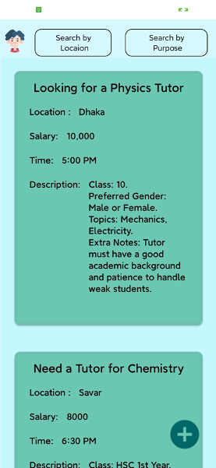
Home Page
The main page of our app displays all posts created by parents, teachers, and students

Slide 15
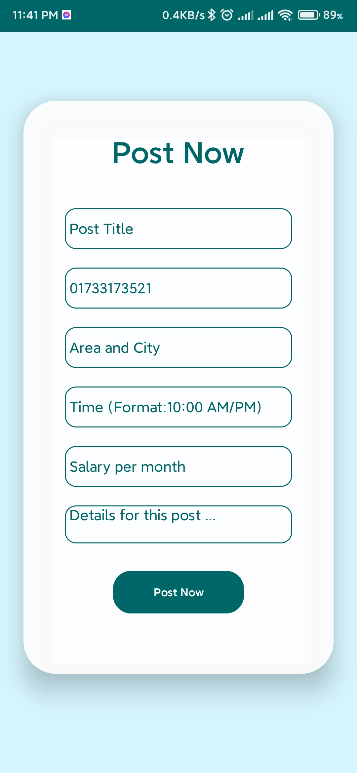
Tution Post

Slide 16
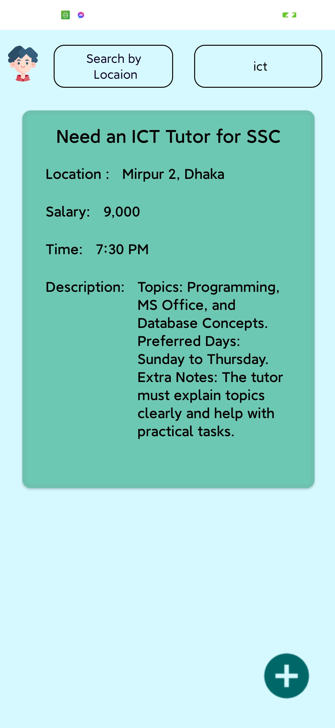
Search By Post Purpose/Title

Slide 17
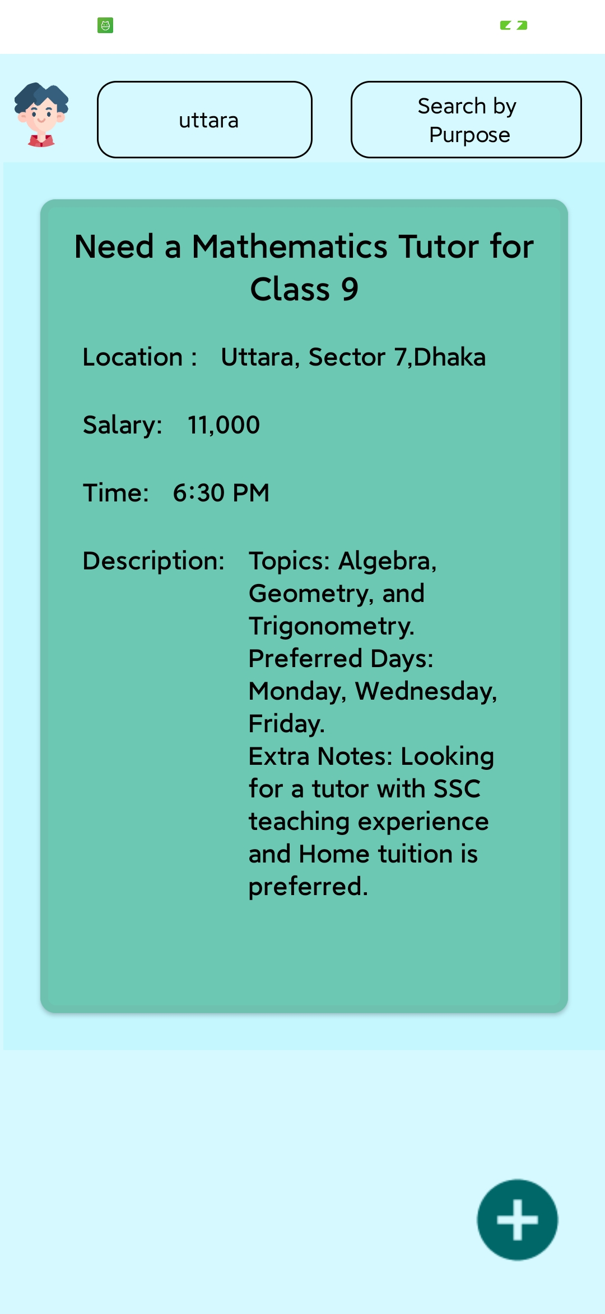
Search By Location or Area

Slide 18
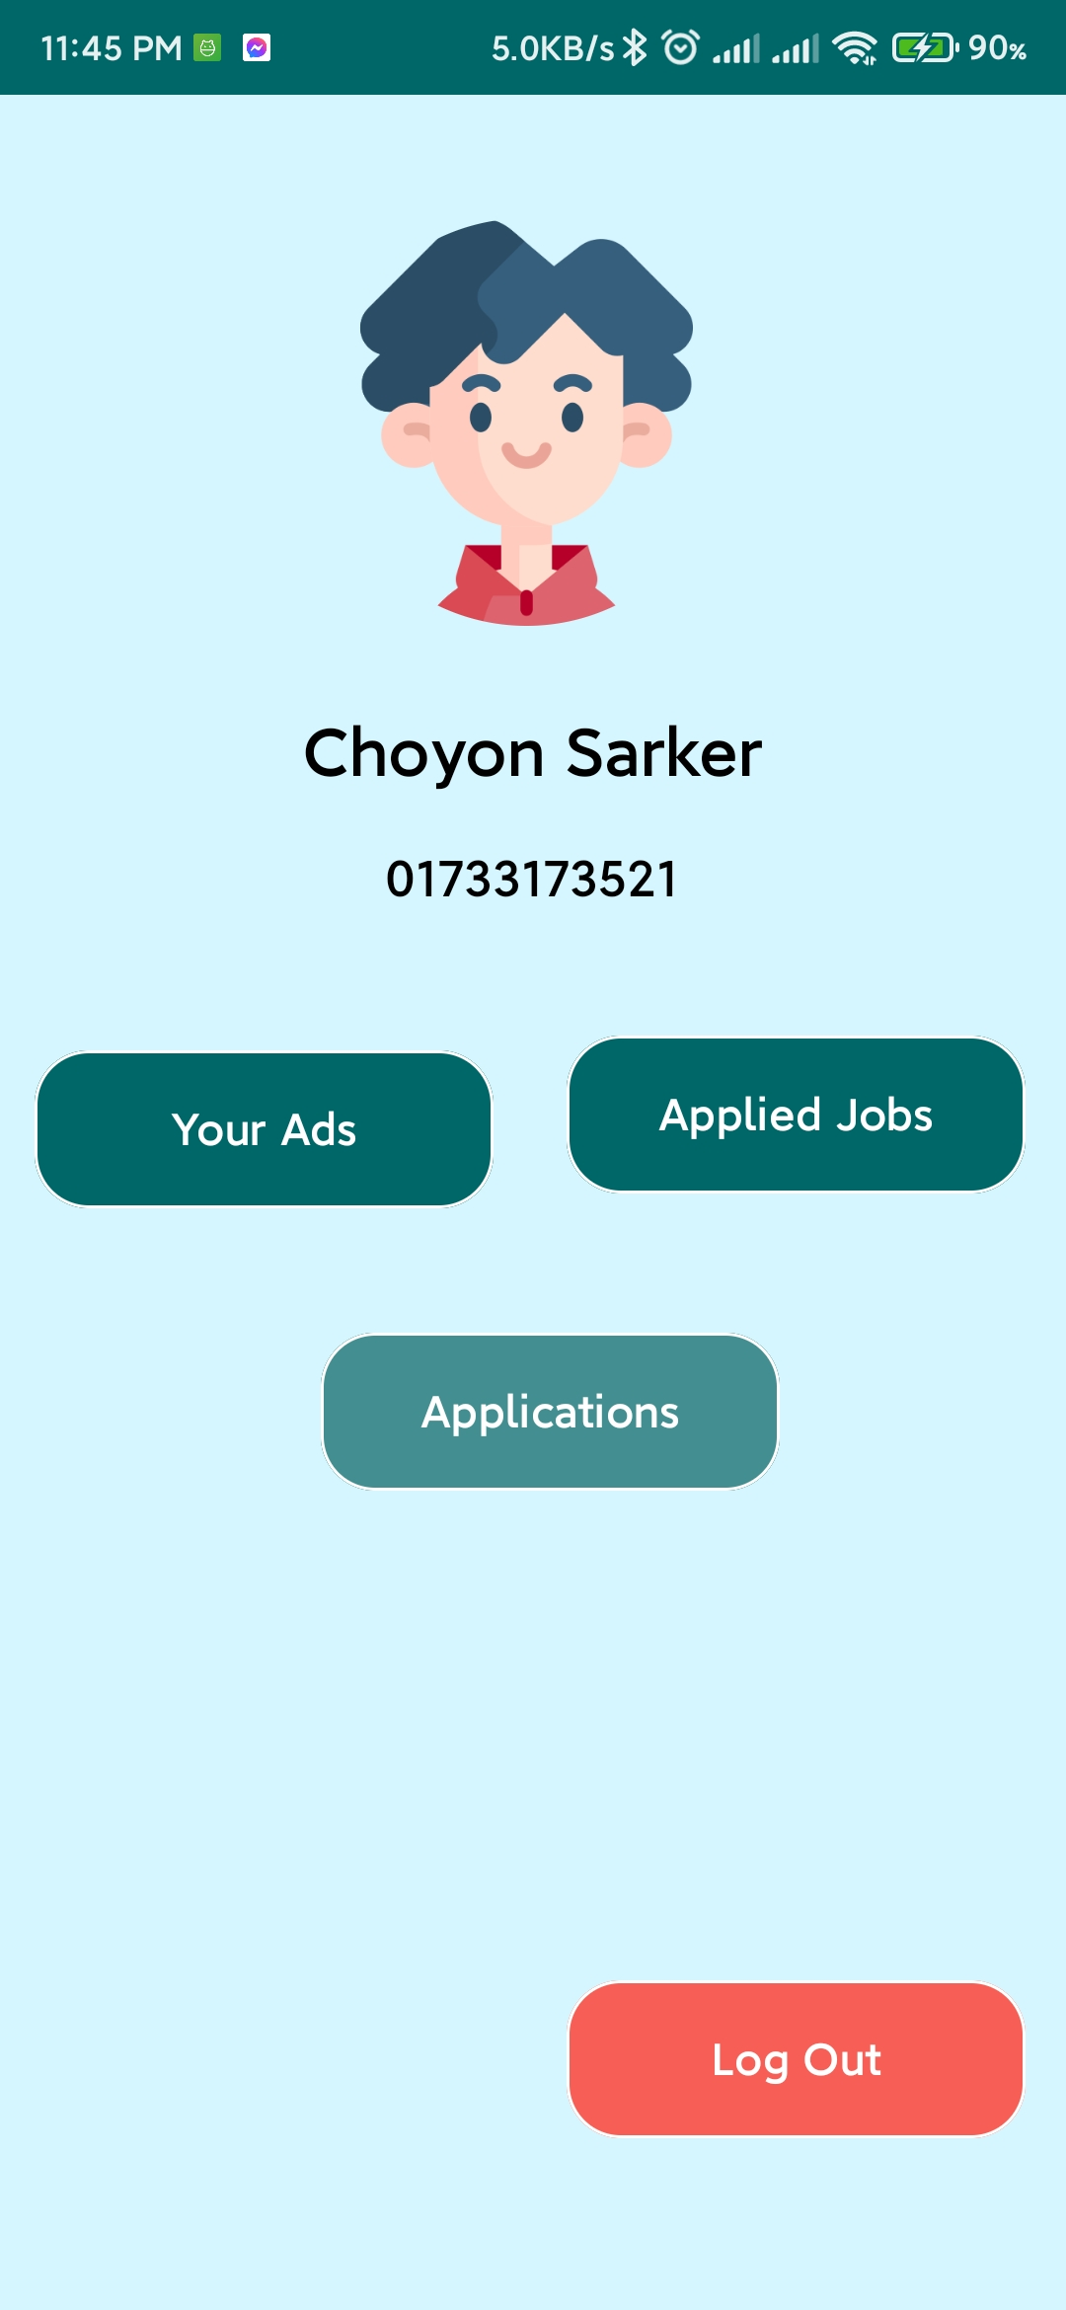
Student Dashboard

Slide 19
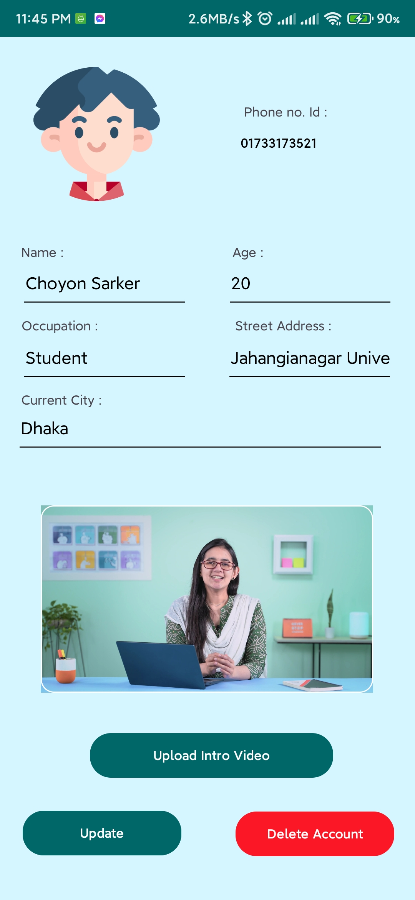
Student Profile Section

Slide 20
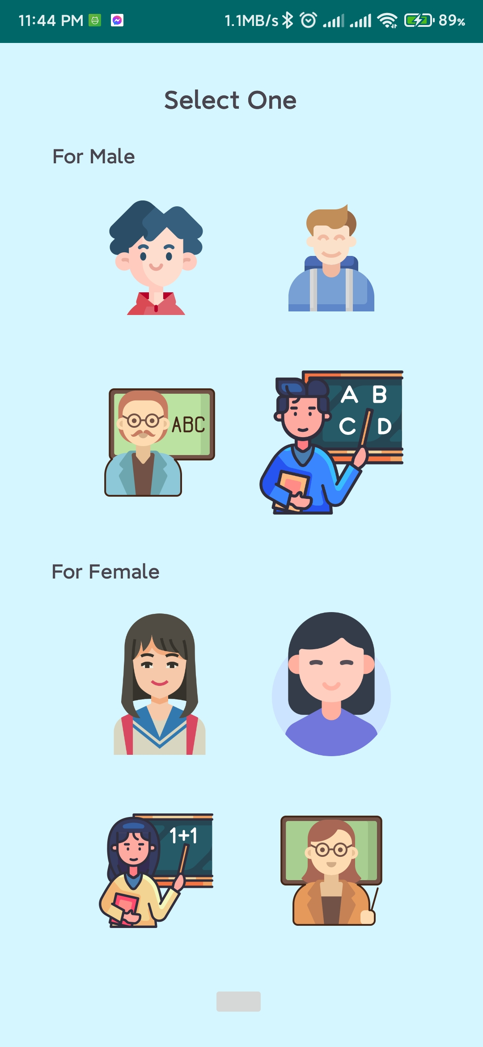
Student Select Profile Picture by Gender and Catagories

Slide 21
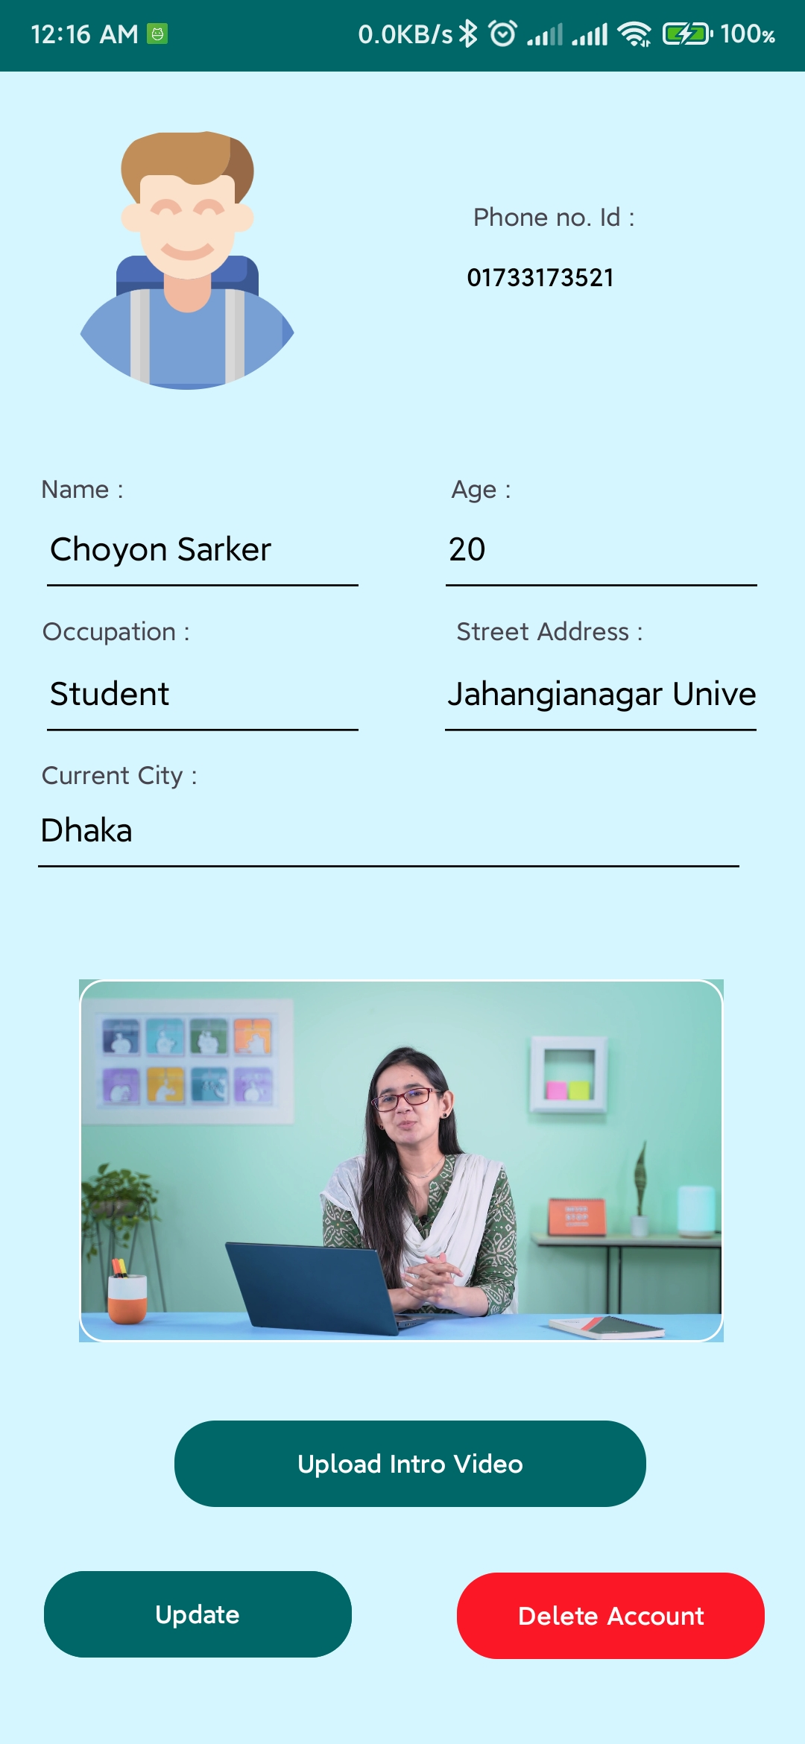
Updated Student Profile Picture

Slide 22
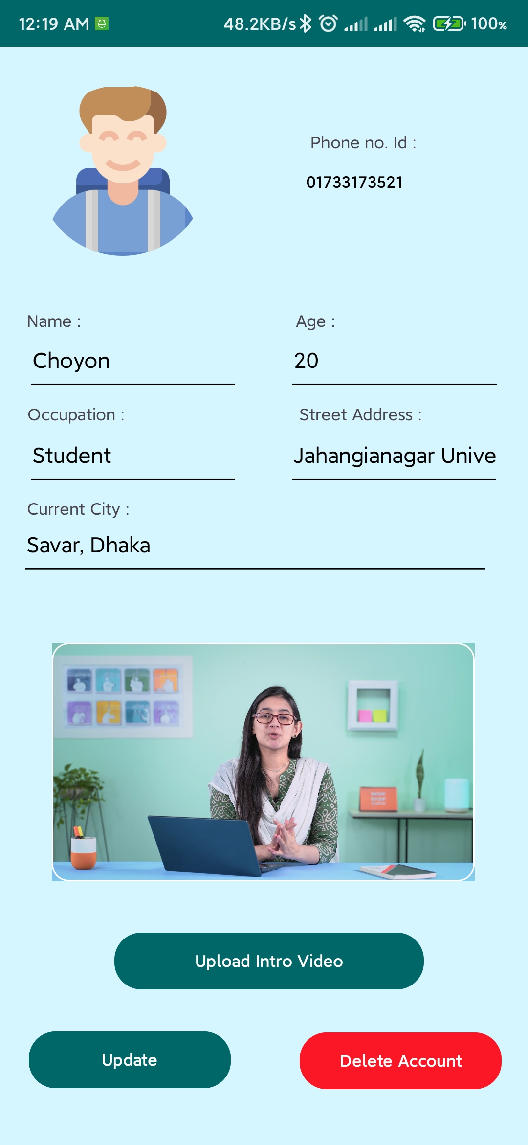
Update Student Profile information and Change Introduction Video

Slide 23
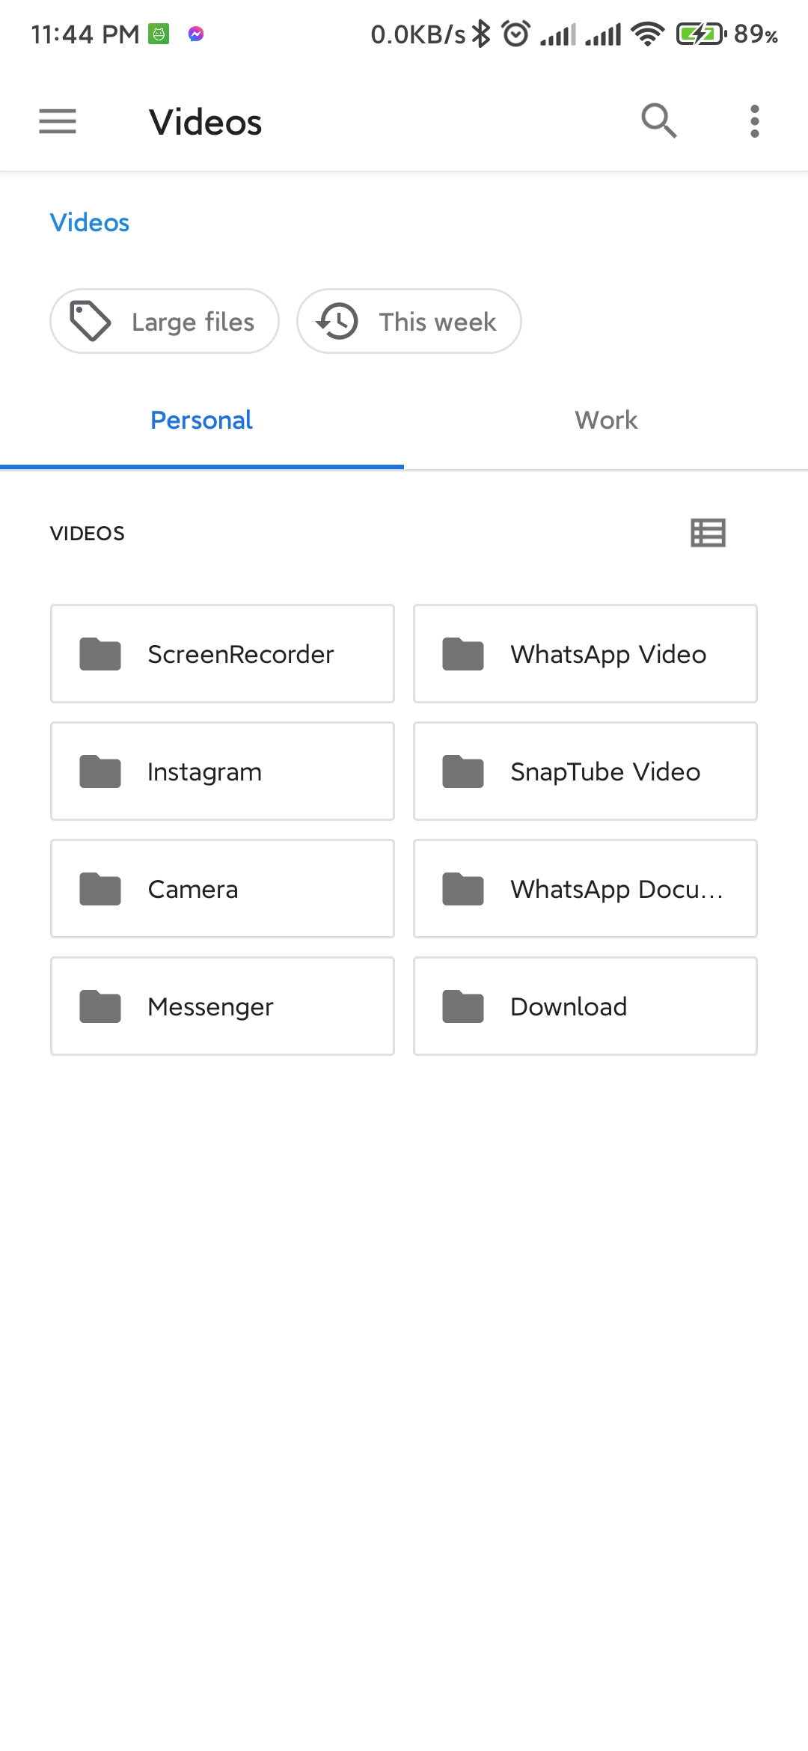
Change introductory video and select from your local files

Slide 24

Student Dashboard’s Your adds section

Slide 25

Student Dashboard’s Application Section

Slide 26
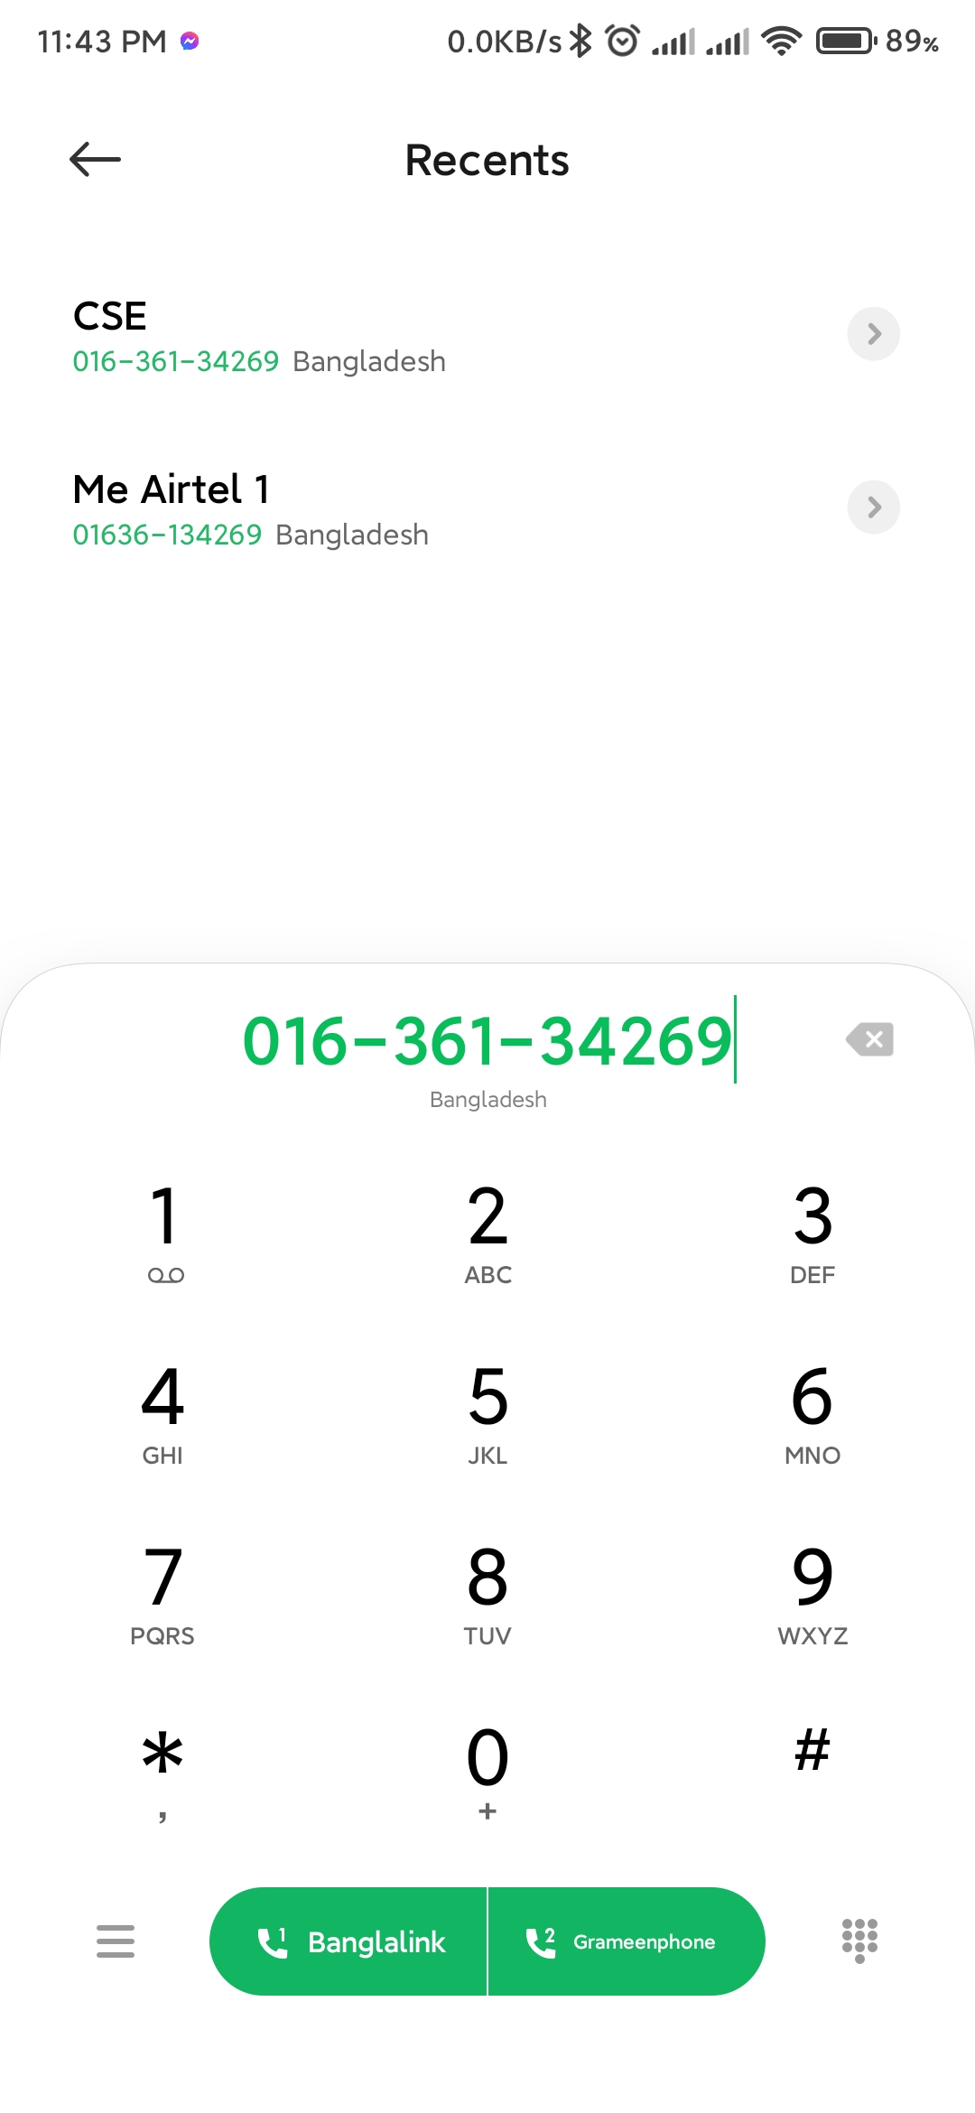
Student can Call Teacher who applied for his post

Slide 27
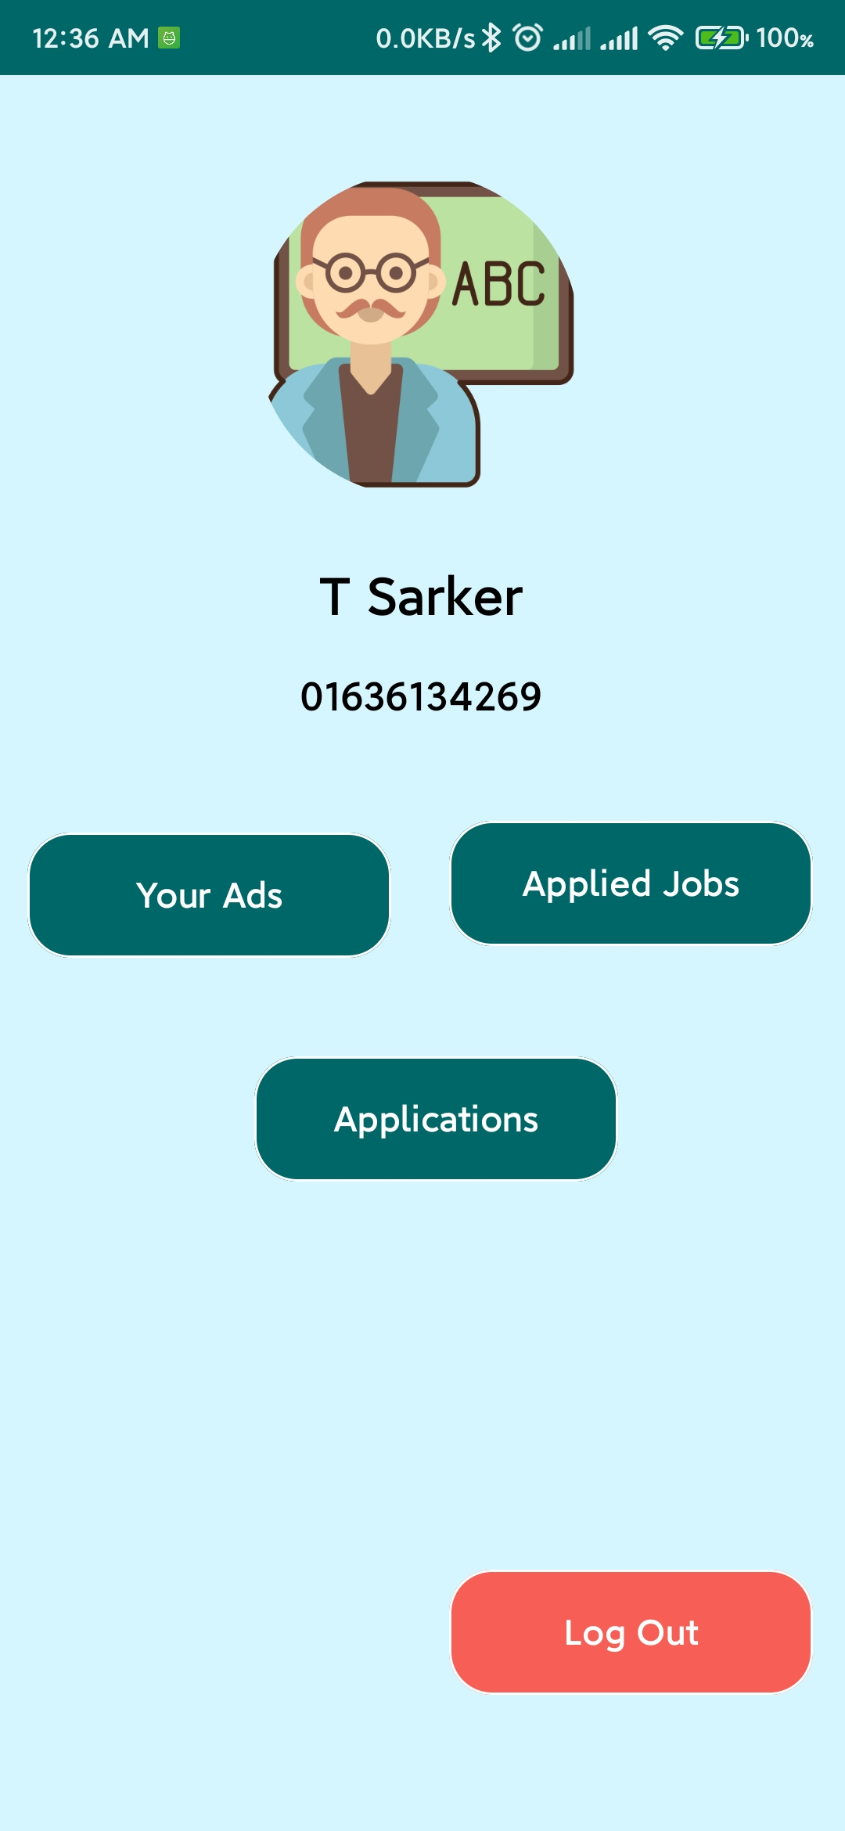
Teacher’s Dashboard

Slide 28

Teacher Dashboard’s Your Ads section

Slide 29
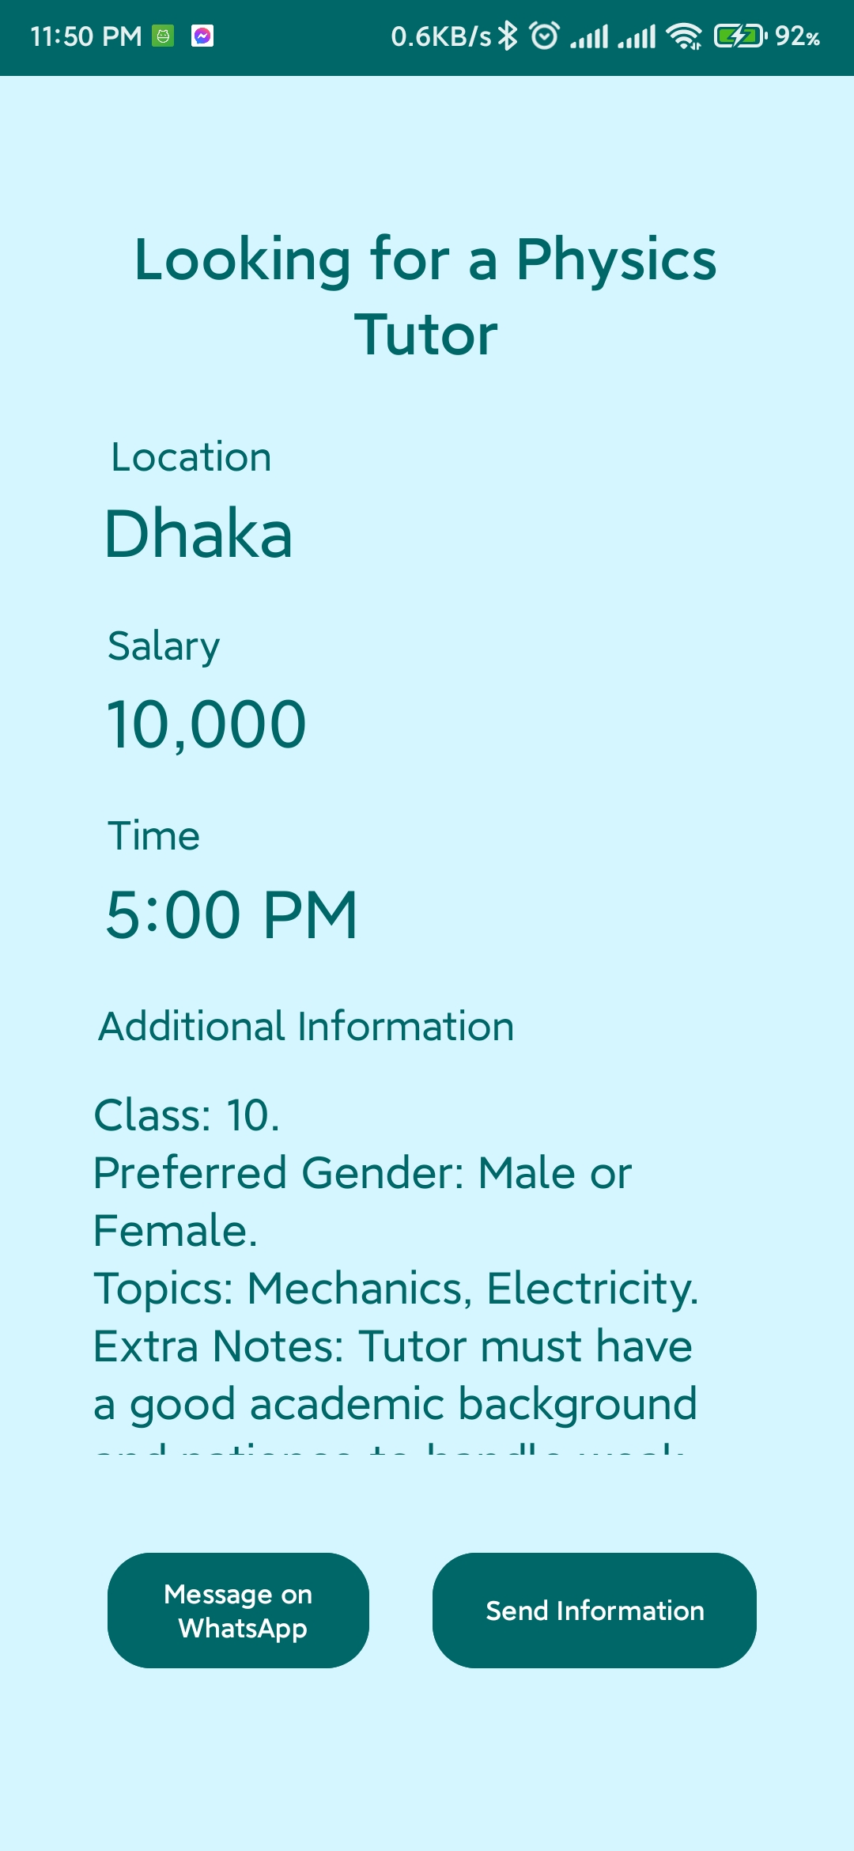
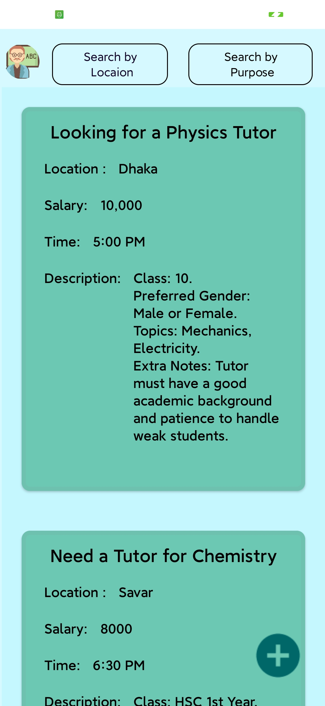
Teacher Apply Students Post

Slide 30
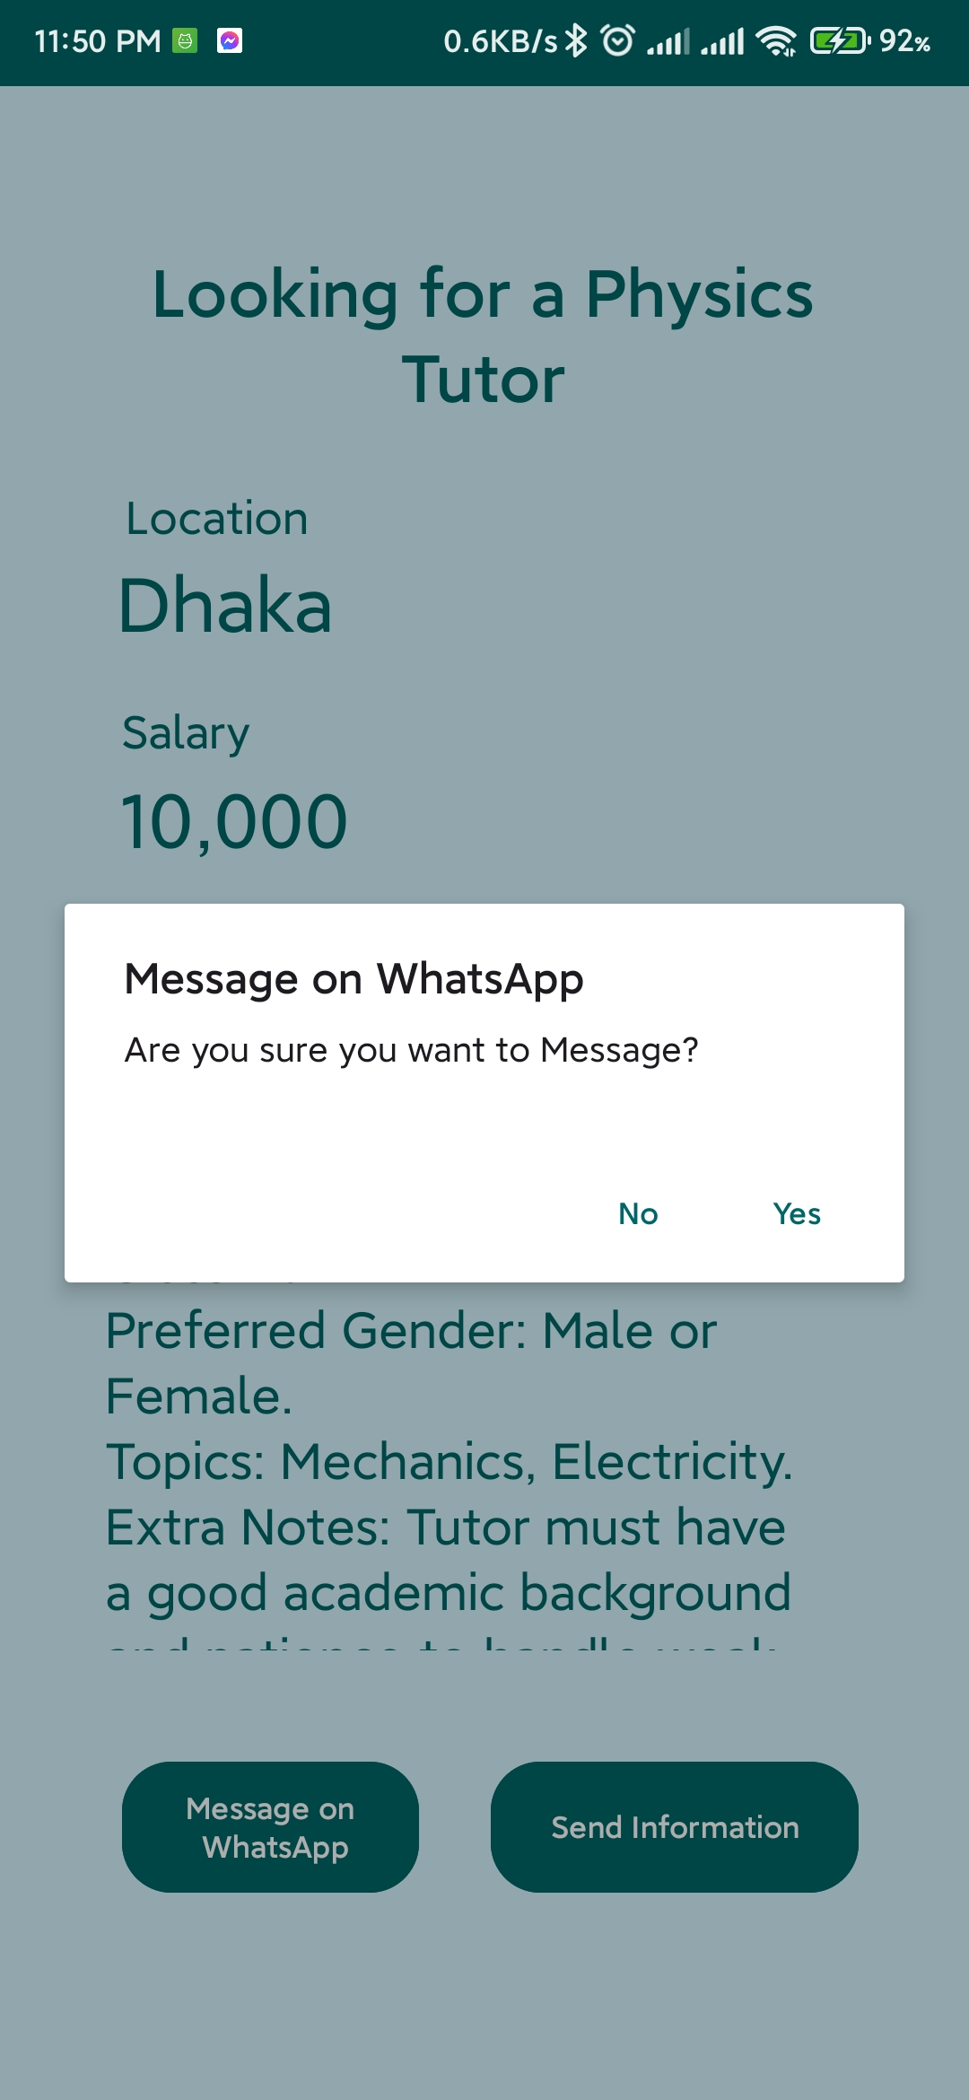
Applier can also chat with the post creator through Whatsapp message

Slide 31
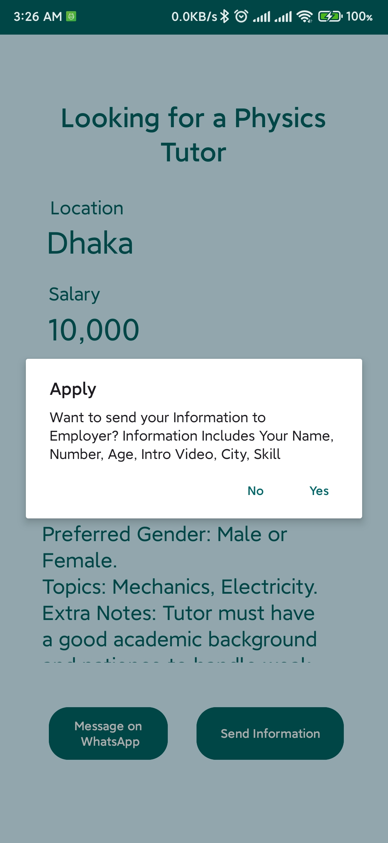
Applier can also send CV

Slide 32
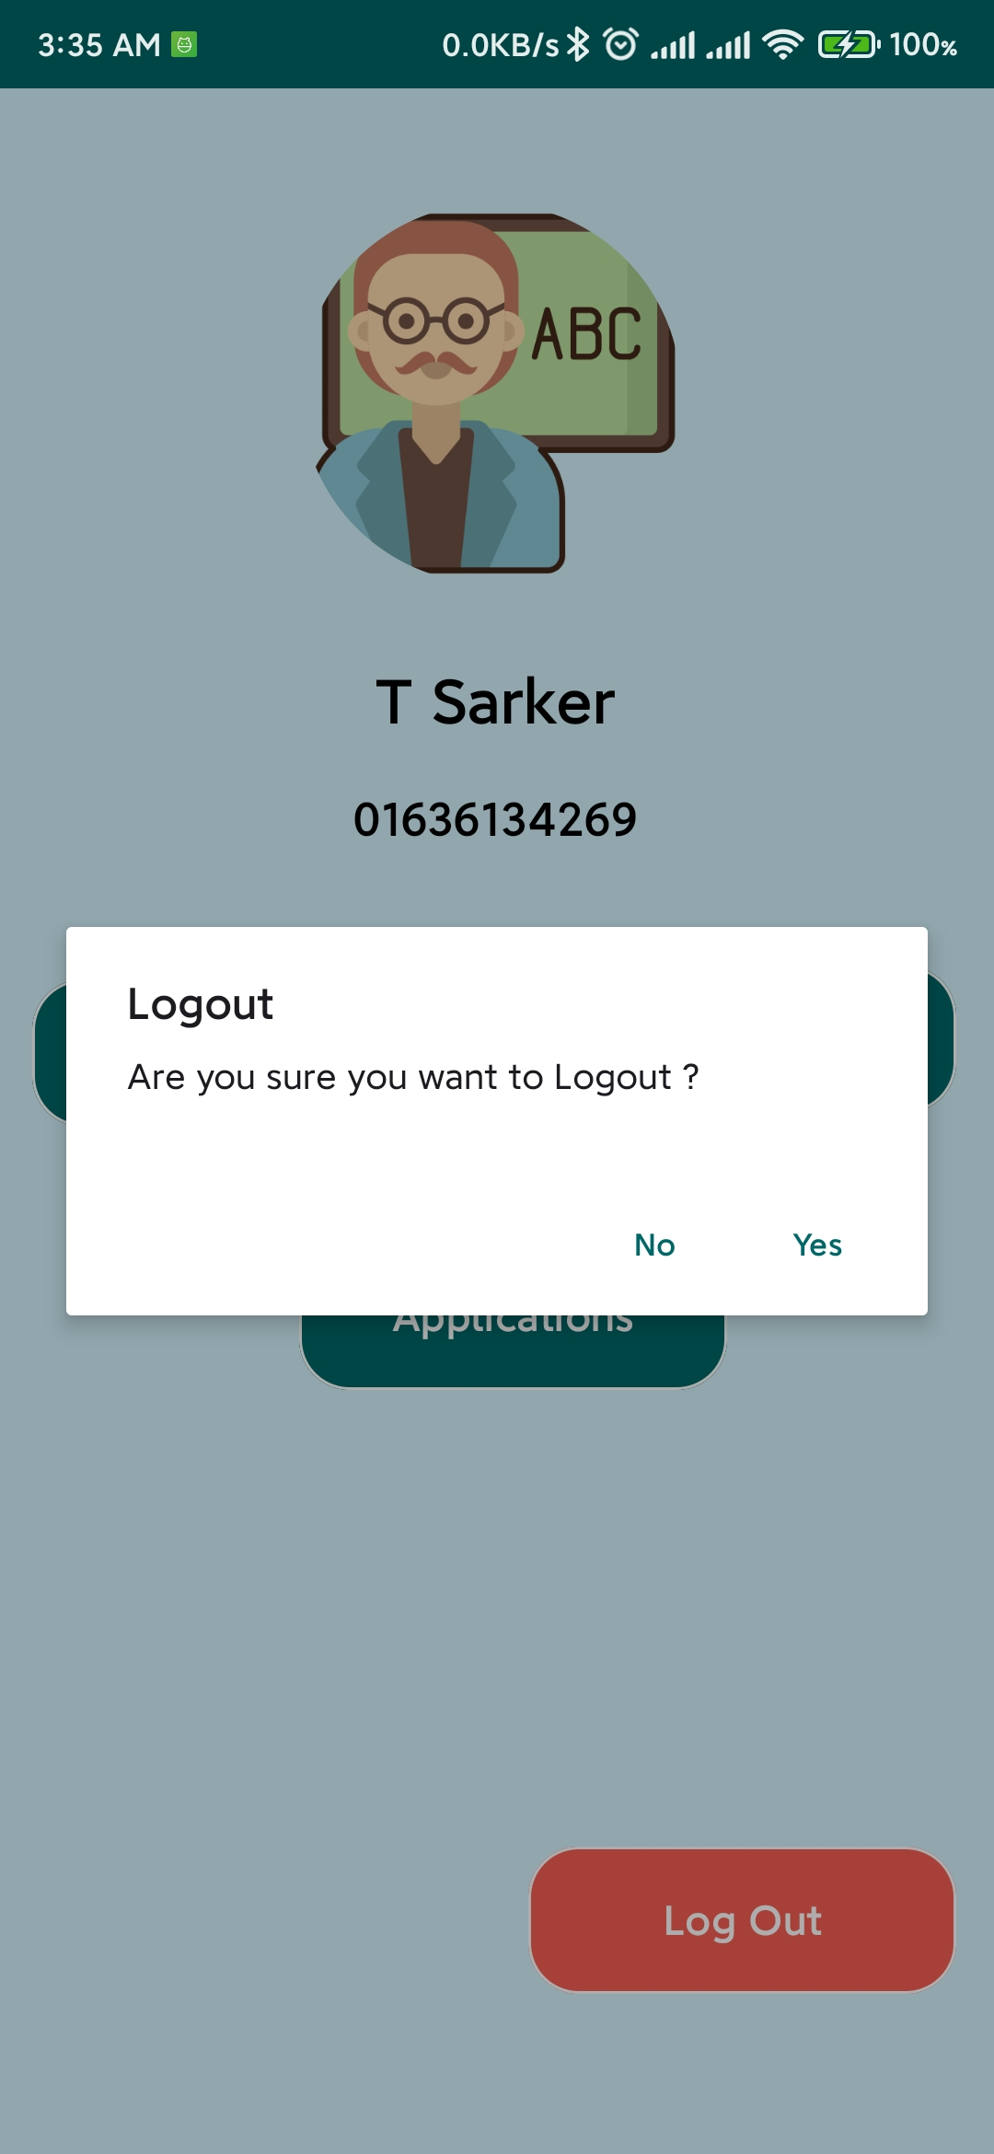
User can log out at the end

Slide 33

Challenges
Ensuring data security and privacy
Attracting initial users to the platform
Maintaining user trust and satisfaction.

Slide 34
Future Enhancement
Expanding to include online tutoring options
Integrating payment systems for seamless transactions
Providing educational resources

Slide 35
Conclusion
Porte Chai revolutionizes the way parents, students, and tutors connect, offering a comprehensive, effective and efficient platform for finding and managing tutoring opportunities.

Slide 36


Slide 37


